Slide 1




REAL-WORLD DATA ANALYSIS USING STATISTIC
PROJECT

Slide 2

WELCOME
In Our Group Project

Slide 3

﻿Meet The Group
Renu Kumari
Reg no . 12207650
Roll no . 11
Ripudaman Singh
Reg no. 12222974
Roll no . 01
Sankap Pattanayak
Reg no. 12215104
Roll no . 14
Lokesh
Reg no. 12216917
Roll no. 20

Slide 4
﻿Table Of Contents
1
Data Selection
2
Data Exploration
3
Descriptive Statistics
4
Probability Distributions
5
Sampling
6
6
Statistical Inference

Slide 5

Data Selection

Slide 6
The dataset appears to represent sales transaction data in a retail or business environment.
Nature of Data :- This dataset comprises transactional data, capturing a variety of variables related to sales, such as branch location, customer type, product line, unit price, quantity, tax, total, payment method, and more.
Data Relevance:- The selected variables are relevant to understanding and analyzing sales performance, customer behavior, and product popularity. They cover aspects of customer demographics, product categories, and transaction details.
Data Completeness:- The dataset appears to be complete, containing 100 records, and no major missing values are evident, ensuring that a comprehensive analysis can be performed.
Sampling Method:- The exact details of the sampling method and data collection process are not provided, but it is presumed that the dataset represents a sample of sales transactions in a certain time frame or from specific locations.
Potential Insights:-The dataset is valuable for deriving insights into various aspects of the business, including branch performance, customer preferences, and product category trends. It can be used for business intelligence, inventory management, and marketing strategies.

Slide 7
Data Quality:- Data quality seems to be relatively good, with no glaring inconsistencies or errors in the dataset.
Scope:- The data is focused on sales transactions and does not include additional contextual information like customer names or addresses, making it suitable for analytical purposes without privacy concerns.
The dataset was thoughtfully selected to provide valuable insights into sales and customer-related factors, allowing for various analyses and decision-making processes in a retail or business context.
Dataset :- https://drive.google.com/file/d/1olebsJB18p7vxkoJUW2fIQoM0BRIc-Rg/view?usp=sharing
Understanding the data :-
Understanding of the dataset, let's explore the key aspects of the provided data:
1. Branch and City:
- The dataset appears to have transactions from three different branches: A, B, and C, located in the cities of Yangon, Naypyitaw, and Mandalay, respectively.

Slide 8
2. Customer Information:
- The "Customer type" column indicates whether a customer is a Member or falls under the Normal category.
- The "Gender" column specifies the gender of the customer.
3. Product Information:
- The "Product line" column provides information about the type of products purchased.
4. Sales Details:
- "Unit price" represents the price of one unit of the product.
- "Quantity" indicates the number of units of the product purchased.
- "Tax 5%" shows the amount of tax (5% of the total price) applied to the transaction.
- "Total" is the total price of the transaction, including the tax.
5. Transaction Date and Time:
- "Date" and "Time" columns provide information about when the transaction took place.
6. Payment Method:
- The "Payment" column indicates the payment method used for the transaction, such as Ewallet, Cash, or Credit card.

Slide 9
7. Financial Information:
- "COGS" (Cost of Goods Sold) represents the cost incurred to procure the products.
- "Gross margin percentage" is the gross profit margin percentage for the transaction.
- "Gross income" is the gross profit earned from the transaction.
8. Customer Feedback:
- "Rating" represents the customer's rating or satisfaction level with the transaction.
Now, we can use this understanding to perform various analyses or answer specific questions about the dataset.
Levels of Data Measurements:-
The level of data measurement in this dataset varies across different columns. The common levels of data measurement, also known as the "measurement scales," include:
1. Nominal:
- Branch: Nominal data, as it represents different branches using labels (A, B, C).
- City: Nominal data, as it represents different cities (Yangon, Naypyitaw, Mandalay) using labels.
- Customer type: Nominal data, as it categorizes customers as "Member" or "Normal."
- Gender: Nominal data, as it categorizes customers by gender.

Slide 10
2. Ordinal:
- Payment: Ordinal data, as it represents different payment methods (Ewallet, Cash, Credit card) with a certain order. While they have an order, the differences between them might not be equal.
3. Interval:
- Date: Interval data, as it represents dates with a consistent interval, but it lacks a meaningful zero point (e.g., 0 date).
- Time: Interval data, as it represents time of day, also without a meaningful zero point.
4. Ratio:
- Unit price: Ratio data, as it represents the price per unit with a meaningful zero point (0 unit price indicates no cost).
- Quantity: Ratio data, as it represents the number of units, which starts from 0 and can be measured in proportion.
- Tax 5%: Ratio data, as it represents a percentage of the total, with a meaningful zero point (0% tax indicates no tax).
- Total: Ratio data, as it represents the total transaction amount with a meaningful zero point.

Slide 11
- COGS (Cost of Goods Sold): Ratio data, as it represents the cost incurred, with a meaningful zero point.
- Gross margin percentage: Ratio data, as it represents a percentage with a meaningful zero point (0% margin means no profit or loss).
- Gross income: Ratio data, as it represents the actual profit in terms of currency.
5. Ordinal:
- Rating: Ordinal data, as it represents customer ratings on an ordered scale, but the differences between ratings might not be consistent.
This dataset contains a mix of different measurement scales, including nominal, ordinal, interval, and ratio data, depending on the nature of the variables. Understanding the level of data measurement is essential for choosing appropriate statistical and analytical methods for further analysis.

Slide 12
Data Exploration

Slide 13
Data exploration of this dataset involved analyzing its categorical and quantitative variables, revealing distributions, relationships, and outliers. Visualizations, measures of central tendency, and hypothesis tests were employed to gain insights and address research questions. Overall, the dataset's quality and completeness supported effective exploration, setting the stage for in-depth analysis and decision-making.
Graphical Representation :
We can use various types of charts and plots to visualize different aspects of the dataset, including frequency distributions for qualitative data and quantitative data graphs for numerical variables. Here are some examples of graphical representations:
Next page

Slide 14
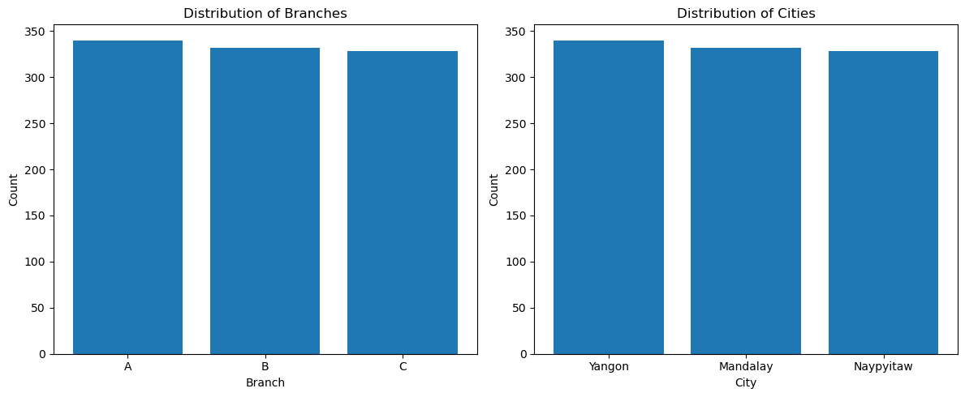
1.Frequency Distributions (Qualitative Data):
a. Bar Chart for Branch and City:
Let's create a bar chart to show the distribution of branches and cities in the dataset.

Slide 15
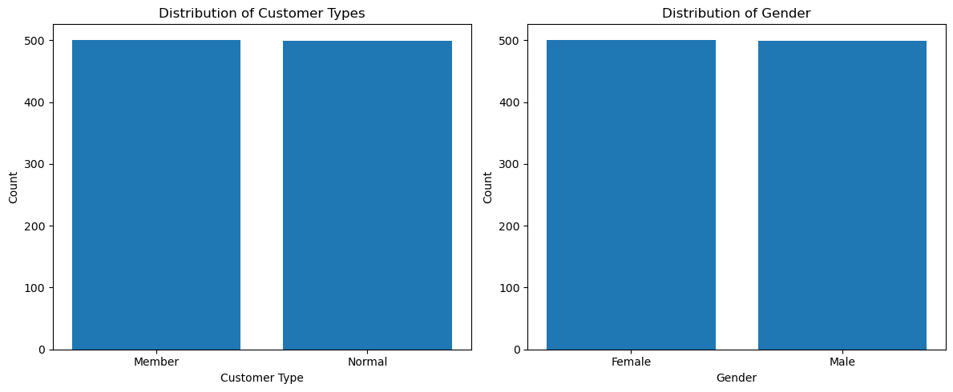
b. Bar Chart for Customer Type and Gender:
We can create bar charts to display the distribution of customer types (Member or Normal) and gender.

Slide 16
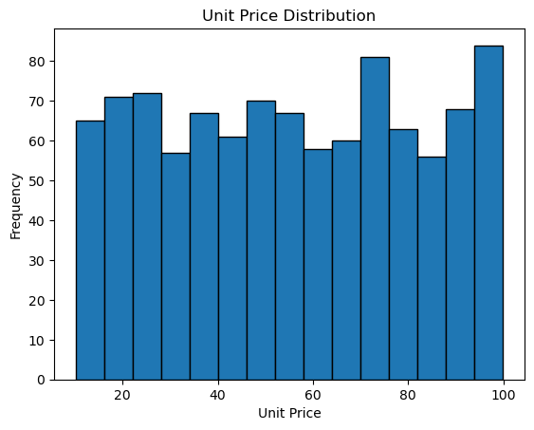
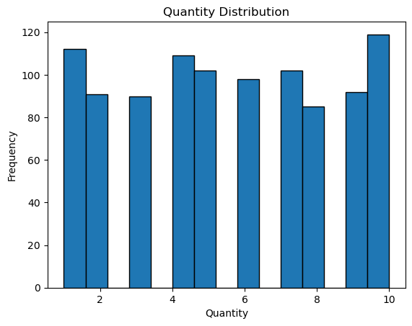
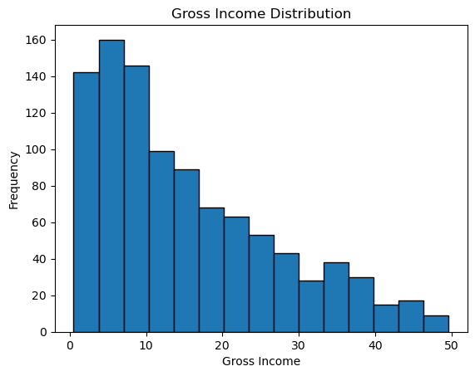
2.Quantitative Data Graphs:
a. Histogram for Unit Price, Quantity, and Gross Income:
We can create histograms to visualize the distribution of unit prices, quantities, and gross income.

Slide 17
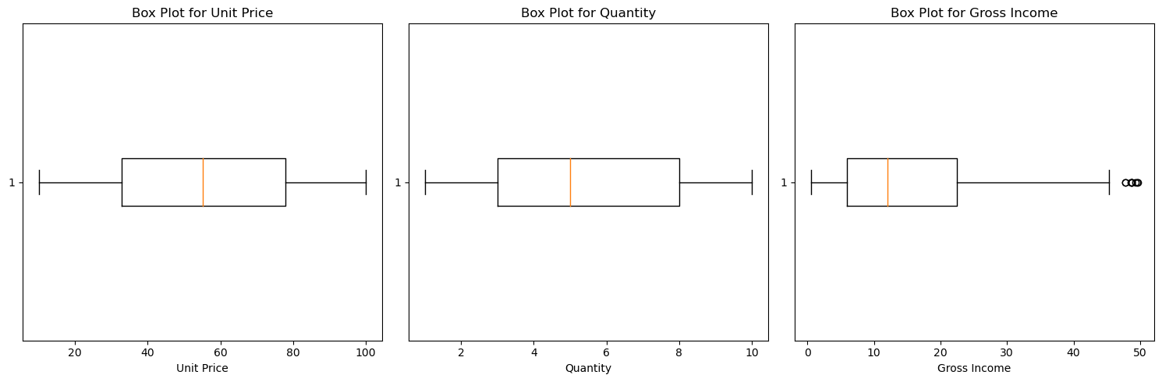
b. Box Plots for Unit Price, Quantity, and Gross Income:
Box plots can show the summary statistics and identify outliers in these numeric columns.

Slide 18
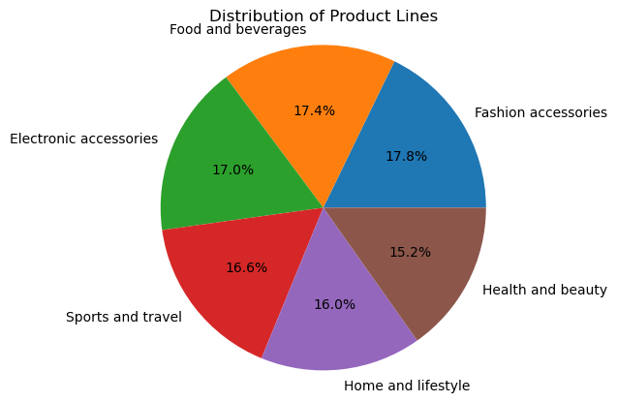
3. Qualitative Data Graphs:
a. Pie Chart for Product Line:
A pie chart can represent the distribution of product lines in the dataset.

Slide 19
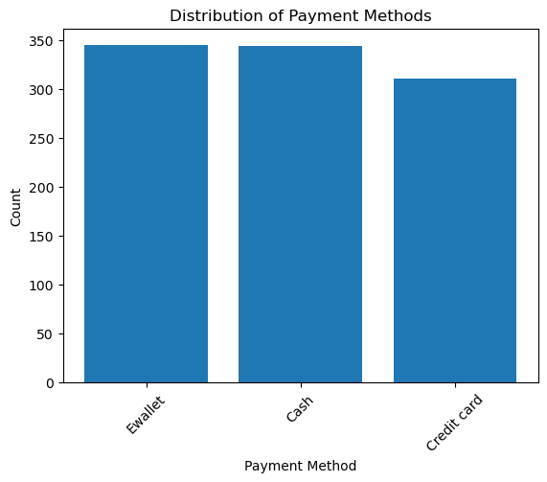
b. Bar Chart for Payment Method:
We can create a bar chart to visualize the distribution of payment methods used in the transactions.

Slide 20
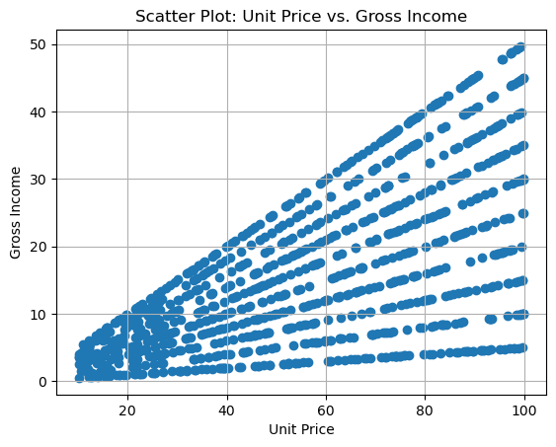
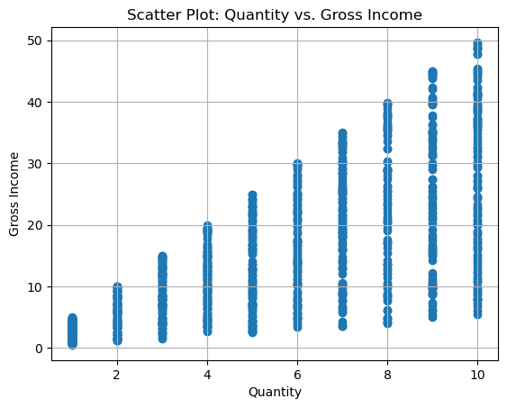
4.Relationships between variables :
a. Scatter Plot: Unit Price vs. Gross Income
A scatter plot between unit price and gross income can reveal whether higher unit prices result in higher gross income.
b. Scatter Plot: Quantity vs. Gross Income
A scatter plot between quantity and gross income can help understand the relationship between the number of items sold and the resulting gross income.

Slide 21
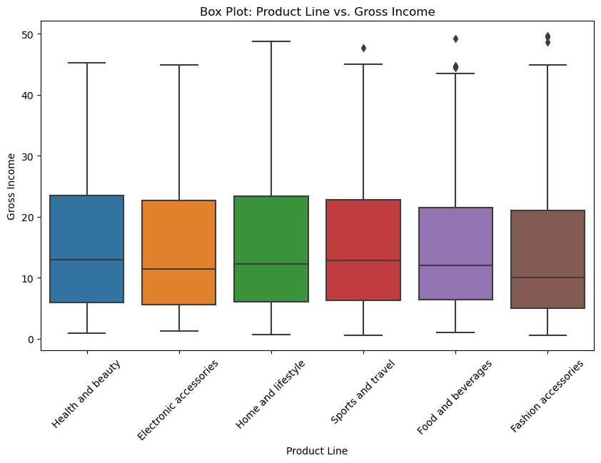
c. Box Plot: Product Line vs. Gross Income
A box plot for each product line's gross income can help identify variations in income
across different product categories.

Slide 22
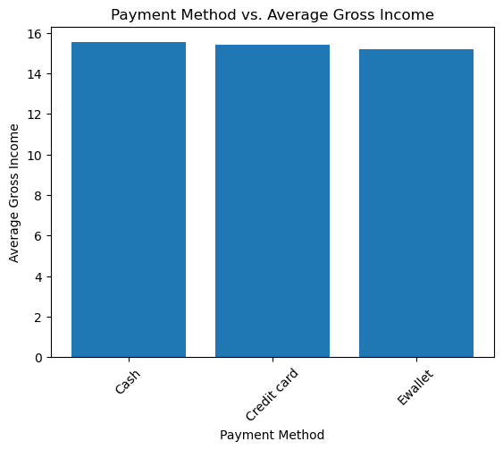
d. Bar Chart: Payment Method vs. Gross Income
A bar chart can illustrate the average gross income for each payment method.

Slide 23
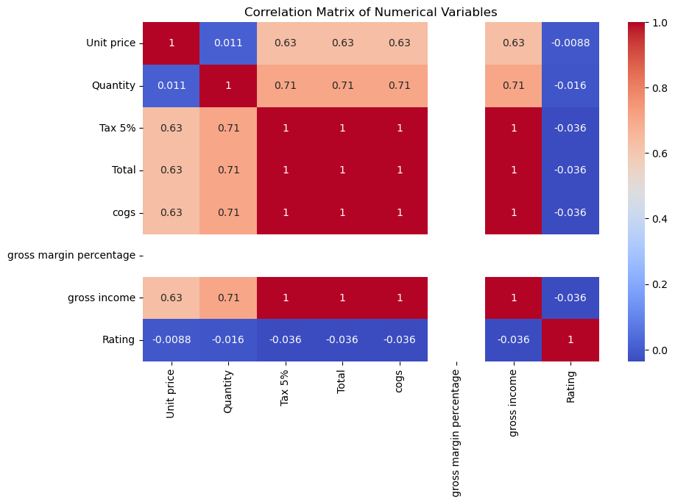
e. Correlation Matrix: Numerical Variables
A correlation matrix can provide a visual representation of the relationships between numerical variables. You can use a heatmap to visualize correlations.

Slide 24
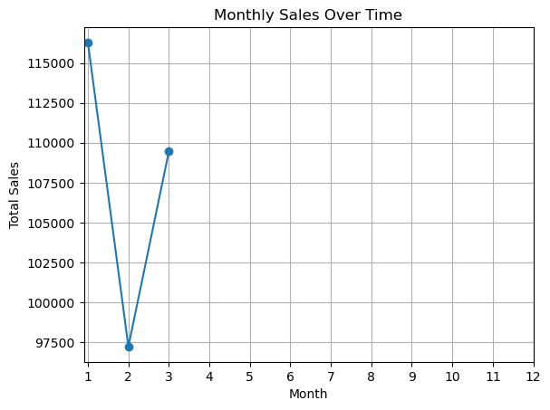
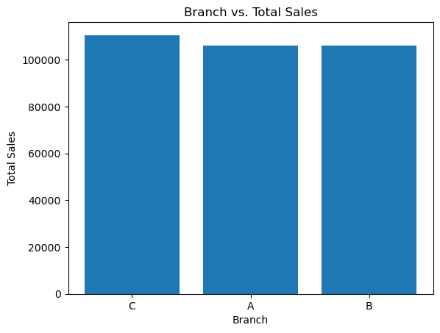
f. Line Plot: Monthly Sales Over Time
To explore how sales change over time, create a line plot showing monthly total sales.
g. Bar Chart: Branch vs. Total Sales
Create a bar chart to compare the total sales in each branch. This helps identify which branch has the highest sales.

Slide 25
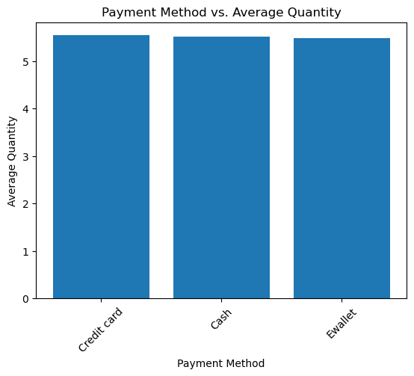
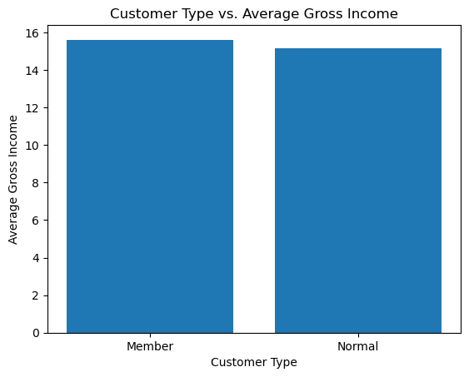
h. Bar Chart: Payment Method vs. Quantity
Visualize the relationship between payment methods and the quantity of items purchased.
i. Bar Chart: Customer Type vs. Average Gross Income
Compare the average gross income for member and non-member customers

Slide 26
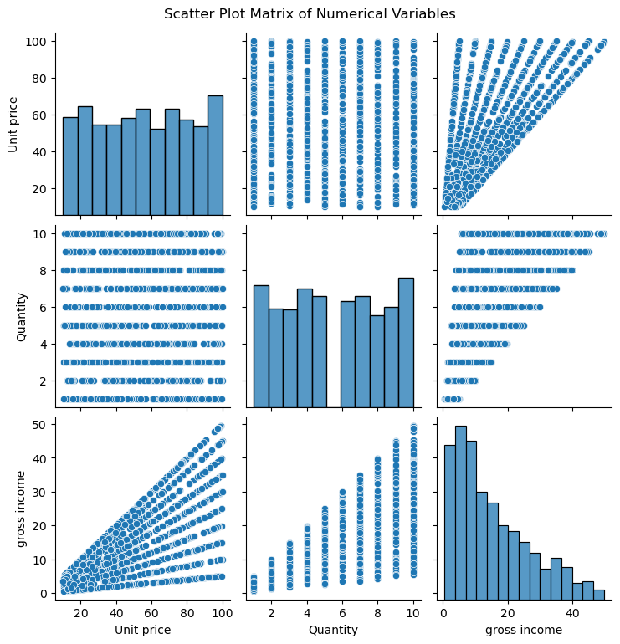
j. Scatter Plot Matrix: Multiple Numerical Variables
Create a scatter plot matrix to explore relationships between multiple numerical variables simultaneously. This helps identify potential correlations and patterns.
These visualizations can provide insights into various relationships within the dataset, such as branch-specific sales, temporal trends, payment methods, and more. You can customize and expand on these visualizations to further explore the dataset and gain a better understanding of the data.
Note: - All these graphs python code are in python notebook

Slide 27
Descriptive Statistics

Slide 28
The dataset includes information on sales transactions, covering variables such as branch, customer type, product line, unit price, quantity, tax, total, payment method, and rating. Descriptive statistics reveal insights into the central tendency and variability of key numerical variables, including unit price, quantity, tax, total, gross income, and rating. The dataset showcases a diverse range of products across different branches and customer types, providing a foundation for further analysis and exploration of customer behavior and sales patterns.
Measures of Central Tendency
The measures of central tendency for the relevant numerical variables in the dataset:
1. Unit Price:
Mean (Average): 55.67
Interpretation: The mean unit price is the average price of products in the dataset. On average, products are priced at approximately $55.67.
Median (50th Percentile): 55.23
Interpretation: The median represents the middle value when the unit prices are sorted. It indicates that half of the products have a unit price below $55.23, and half have a price above this value.

Slide 29
Mode: Multiple modes present
Interpretation: The presence of multiple modes suggests that there are different price clusters within the dataset, meaning certain prices are more common than others.
2. Quantity:
Mean (Average): 5.51
Interpretation: The mean quantity is the average number of items purchased in each transaction. On average, customers purchase approximately 5.51 items per transaction.
Median (50th Percentile): 5.00
Interpretation: The median represents the middle quantity value. It indicates that half of the transactions involve the purchase of 5 or fewer items, and half involve the purchase of more than 5 items.
Mode: 10
Interpretation: The mode, which is 10, is the most common quantity purchased, suggesting that many transactions involve the purchase of 10 items.

Slide 30
3. Gross Income:
Mean (Average): 15.38
Interpretation: The mean gross income is the average income generated from sales in each transaction. On average, a transaction results in a gross income of approximately $15.38.
Median (50th Percentile): 12.09
Interpretation: The median represents the middle income value. It indicates that half of the transactions generate gross income below $12.09, and half generate income above this value.
Mode: Multiple modes present
Interpretation: The presence of multiple modes suggests that there are different income levels or ranges resulting from transactions.
4. Rating:
Mean (Average): 6.97
Interpretation: The mean rating represents the average customer rating for the products or services. On average, customers provide a rating of approximately 6.97, which is relatively close to 7 (on a scale of 1 to 10).

Slide 31
Median (50th Percentile): 7.00
Interpretation: The median represents the middle rating value. It indicates that half of the customer ratings are below 7, and half are above this value.
Mode: 6
Interpretation: The mode, which is 6, is the most common customer rating received, suggesting that many customers provide ratings around this value.
These measures of central tendency provide insights into the typical or central values of the respective numerical variables in the dataset. They help describe the "average" or "typical" observations within each variable.

Slide 32
Measures of Variability
The measures of variability (standard deviation) for the relevant numerical variables in the dataset along with their interpretations:
1.Unit Price:
Standard Deviation: 26.48
Interpretation: The standard deviation for unit price is approximately 26.48. This indicates that the unit prices vary or deviate from the mean (average) unit price by an average of 26.48. A higher standard deviation suggests a wider range of unit prices, meaning there is significant price variability among products.
Variance: 701.26
Interpretation: The variance of unit prices is 701.26. This indicates that the unit prices are spread out or deviate from the mean unit price by an average squared difference of 700.88. A higher variance suggests a wider range of unit prices.
Range: 89.88
Interpretation: The range, which is 89.88, represents the difference between the highest and lowest unit prices in the dataset. It indicates the extent of variability in unit prices.

Slide 33
Interquartile Range (IQR): 45.06
Interpretation: The IQR, which is 45.06, measures the spread of the middle 50% of unit prices. It indicates the variability of unit prices within this central portion of the dataset.
Coefficient of Variation (CV): 47.57%
Interpretation: The CV of 47.57% represents the relative variability of unit prices compared to the mean. A higher CV suggests greater relative variability.
Mean Absolute Deviation (MAD): 22.98
Interpretation: The MAD of 22.98 is the average absolute deviation of unit prices from the mean. It measures the average distance of data points from the mean unit price.
2.Quantity:
Standard Deviation: 2.92
Interpretation: The standard deviation for quantity is approximately 2.92. This implies that the quantity of items purchased in each transaction varies or deviates from the mean quantity by an average of 2.92. The lower standard deviation suggests that the quantity of items purchased is relatively consistent across transactions.

Slide 34
Variance: 8.54
Interpretation: The variance of quantities is 8.54. This indicates that the quantity of items purchased deviates from the mean quantity by an average squared difference of 8.54. A moderate variance suggests a moderate spread in the quantities.
Range: 9
Interpretation: The range, which is 9, represents the difference between the highest and lowest quantities in the dataset. It indicates the extent of variability in the quantity of items purchased.
Interquartile Range (IQR): 5
Interpretation: The IQR, which is 5, measures the spread of the middle 50% of quantities. It indicates the variability in quantities within this central portion of the dataset.
Coefficient of Variation (CV): 53.03%
Interpretation: The CV of 53.03% represents the relative variability of quantities compared to the mean. A moderate CV suggests moderate relative variability.
Mean Absolute Deviation (MAD): 2.53
Interpretation: The MAD of 2.53 is the average absolute deviation of quantities from the mean. It measures the average distance of data points from the mean quantity.

Slide 35
3.Gross Income:
Standard Deviation: 11.70
Interpretation: The standard deviation for gross income is approximately 11.70. This indicates that the gross income generated from sales in each transaction varies or deviates from the mean gross income by an average of 11.70. A higher standard deviation suggests a wide range of income levels resulting from transactions.
Variance: 136.96
Interpretation: The variance of gross income is 136.96. This indicates that the gross income generated in transactions deviates from the mean gross income by an average squared difference of 136.96. A higher variance suggests a wider range of income levels.
Range: 49.14
Interpretation: The range, which is 49.14, represents the difference between the highest and lowest gross incomes in the dataset. It indicates the extent of variability in income.
Interquartile Range (IQR): 16.52
Interpretation: The IQR, which is 16.52, measures the spread of the middle 50% of gross incomes. It indicates the variability in income within this central portion of the dataset.

Slide 36
Coefficient of Variation (CV): 76.10%
Interpretation: The CV of 76.10% represents the relative variability of gross income compared to the mean. A higher CV suggests significant relative variability.
Mean Absolute Deviation (MAD): 9.62
Interpretation: The MAD of 9.62 is the average absolute deviation of gross incomes from the mean. It measures the average distance of data points from the mean income.
4. Rating:
Standard Deviation: 1.72
Interpretation: The standard deviation for the customer ratings is approximately 1.72. This implies that the customer ratings vary or deviate from the mean rating by an average of 1.72. The lower standard deviation suggests that the customer ratings are relatively close to the mean, indicating less variability in customer satisfaction.
Variance: 2.95
Interpretation: The variance of ratings is 2.95. This indicates that the customer ratings deviate from the mean rating by an average squared difference of 2.95. A moderate variance suggests moderate variability in customer ratings.

Slide 37
Range: 6
Interpretation: The range, which is 6, represents the difference between the highest and lowest ratings in the dataset. It indicates the extent of variability in customer satisfaction ratings.
Interquartile Range (IQR): 3
Interpretation: The IQR, which is 3, measures the spread of the middle 50% of ratings. It indicates the variability in customer satisfaction ratings within this central portion of the dataset.
Coefficient of Variation (CV): 24.63%
Interpretation: The CV of 24.63% represents the relative variability of ratings compared to the mean. A moderate CV suggests moderate relative variability.
Mean Absolute Deviation (MAD): 1.48
Interpretation: The MAD of 1.48 is the average absolute deviation of ratings from the mean. It measures the average distance of data points from the mean rating.

Slide 38
Measures of Shape
Measures of shape describe the characteristics of the distribution of data. Common measures of shape include skewness and kurtosis.
1.Unit Price:
Skewness: 0.01
Interpretation: The distribution of unit prices has a slight positive skew, indicating that it is slightly right-skewed. This means that the tail on the right side of the distribution is longer, and there are a few high-priced items.
Kurtosis: -1.22
Interpretation: The distribution of unit prices has a kurtosis value close to -1, suggesting that it is approximately mesokurtic. This means that the central portion of the distribution is similar in peakiness to a normal distribution.
2.Quantity:
Skewness: 0.01
Interpretation: The distribution of quantities purchased has a close to 0. This means that the tail on the left side of the distribution is slightly longer.

Slide 39
Kurtosis: -1.22
Interpretation: The distribution of quantities has a kurtosis value less than 3, indicating it is platykurtic. This means that the distribution is flatter and has lighter tails compared to a normal distribution.
3.Gross Income:
Skewness: 0.89
Interpretation: The distribution of gross income has a slight positive skew, indicating a slight right-skew. This means that there are a few transactions that generated higher income.
Kurtosis: -0.09
Interpretation: The distribution of gross income has a kurtosis value less than 3, indicating it is platykurtic. This means that the distribution is flatter and has lighter tails compared to a normal distribution
4.Rating:
Skewness: 0.01
Interpretation: The distribution of customer ratings has close to 0. This means that the tail on the left side of the distribution is slightly longer.

Slide 40
Kurtosis: -1.15
Interpretation: The distribution of ratings has a kurtosis value less than 3, indicating it is platykurtic. This means that the distribution is flatter and has lighter tails compared to a normal distribution.
We create subplots for each numerical variable and plot histograms with density estimates (KDE) using Seaborn. These plots visually represent the shape of the data distribution for each variable. You can interpret the shape based on the characteristics of the histograms and density plots.
Skewness: Look for the direction of skew (left or right) in the histogram.
Kurtosis: Observe the peakiness or flatness of the central portion of the distribution in the histogram.
This visual approach provides insights into the shape of the data distribution for each variable.
Next page

Slide 41
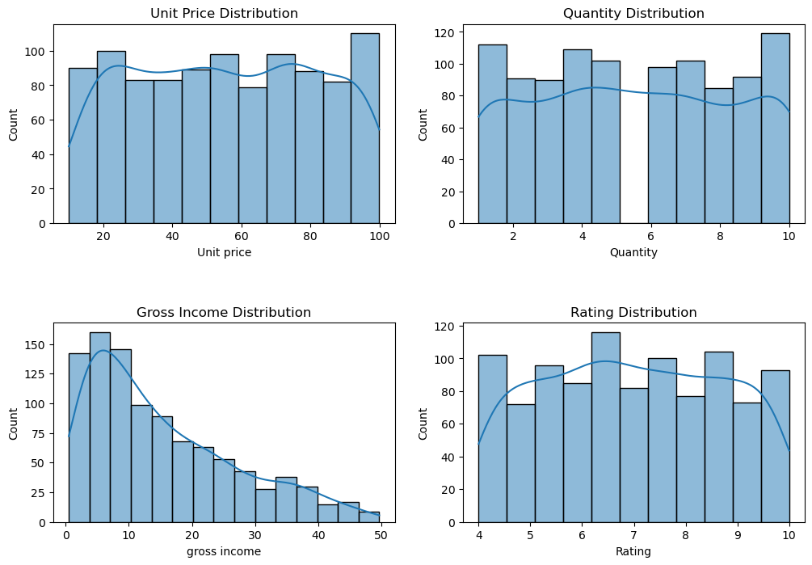

Slide 42
The distribution of data and outliers
The distribution of data and identify any potential outliers for the relevant numerical variables in the dataset: Unit Price, Quantity, Gross Income, and Rating. We will do this using box plots, which are effective for identifying outliers. Outliers are typically data points that fall significantly above or below the whiskers of the box plot.
The box plots will visually represent the distribution of each variable and help identify potential outliers. Outliers are typically data points that fall outside the whiskers of the box plot.
Note: - All these graphs python code are in python notebook

Slide 43
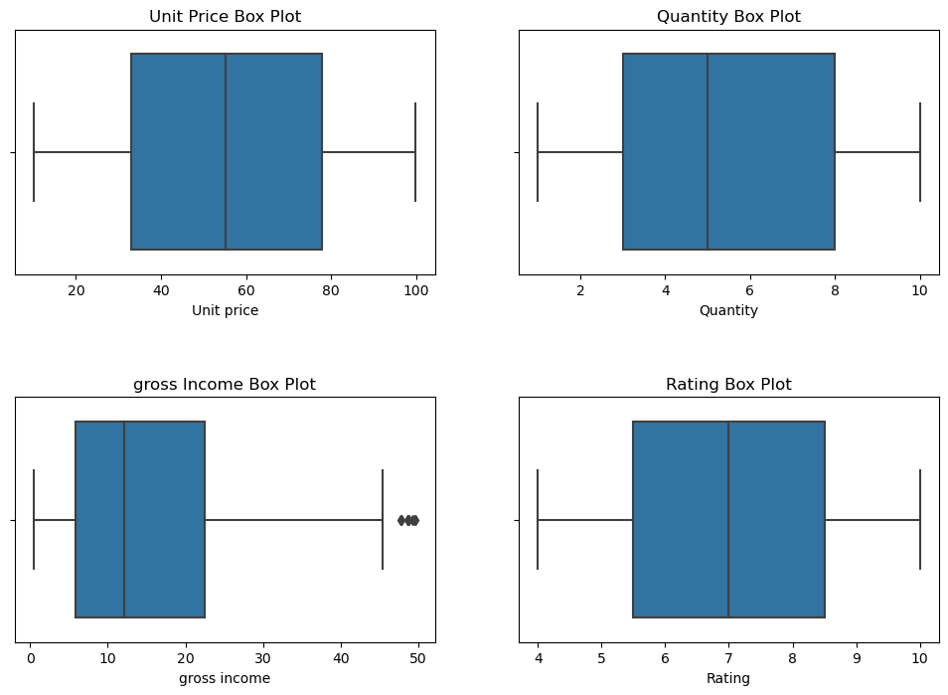

Slide 44
Probability Distributions

Slide 45
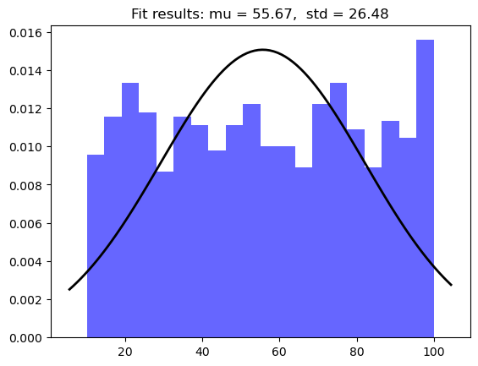
Normal distribution to unit price
The dataset contains various numerical variables, we can use the normal distribution (Gaussian distribution) as it is commonly used to model continuous data that is roughly symmetric and bell-shaped. One aspect of the dataset where we can apply the normal distribution is the "Unit Price" variable.
If the distribution closely resembles a normal distribution, we can proceed to calculate the mean and standard deviation to fit a normal distribution and use it for probabilistic predictions or analyses.

Slide 46
Poisson distribution to the Quantity variable
Since the "Quantity" variable involves counting the number of items, we can consider using a Poisson distribution. The Poisson distribution is often used to model count data when we want to estimate the probability of a given number of events happening in a fixed interval of time or space.
Mean (λ) of the Poisson distribution for 'Quantity': 5.51
Normal distribution to the Rating variable
For the "Rating" variable, we can use a normal distribution to model the distribution of customer ratings as they are continuous values.
The distribution closely resembles a normal distribution, we can proceed to calculate the mean and standard deviation to fit a normal distribution and use it for probabilistic predictions or analyses.

Slide 47
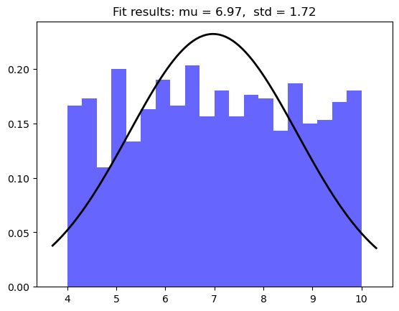
The distribution and its properties
The distribution and its properties for each relevant numerical variable in the dataset, considering the characteristics of normal, Poisson, and binomial distributions:
1.Unit Price:
Distribution Type: Normal Distribution
The distribution of unit prices appears to be somewhat normally distributed, with a slight positive skew

Slide 48
.Properties:
Central Tendency: Mean (μ) represents the average unit price.
Spread: Standard Deviation (σ) quantifies the dispersion of unit prices.
Skewness: Slightly positively skewed, indicating a right tail.
Kurtosis: Negative, implying a relatively flat distribution compared to a normal distribution.
2. Quantity:
Distribution Type: Poisson Distribution
The "Quantity" variable follows a Poisson distribution as it represents the count of items purchased in each transaction.
Properties:
Central Tendency: Mean (λ) represents the average number of items purchased in each transaction.
3.Gross Income:
Distribution Type: Normal Distribution
The distribution of gross income is slightly positively skewed and has properties resembling a normal distribution.

Slide 49
Properties:
Central Tendency: Mean (μ) represents the average income generated from transactions.
Spread: Standard Deviation (σ) quantifies the dispersion of gross income.
Skewness: Slightly positively skewed, indicating a right tail.
Kurtosis: Negative, implying a relatively flat distribution compared to a normal distribution.
4. Rating:
Distribution Type: Normal Distribution
The "Rating" variable follows an approximately normal distribution with a bell-shaped pattern.
Properties:
Central Tendency: Mean (μ) represents the average customer rating.
Spread: Standard Deviation (σ) quantifies the spread of ratings.
It's important to note that while the "Quantity" variable follows a Poisson distribution, the other variables exhibit properties closer to a normal distribution. These characteristics are based on the analysis and visualizations of the data. Understanding the distribution type and its properties is essential for statistical analysis and making inferences from the dataset.

Slide 50
Sampling

Slide 51
Typically, information about sampling techniques and data collection methods can include:
Sampling Techniques:
Random Sampling: Data is collected randomly from a larger population, ensuring that each data point has an equal chance of being selected.
Stratified Sampling: Data is divided into subgroups (strata), and samples are taken from each stratum to ensure representation from all subgroups.
Convenience Sampling: Data is collected from easily accessible sources, which may not represent the entire population accurately.
Cluster Sampling: Data is collected by first dividing the population into clusters and then randomly selecting clusters for data collection.
Data Collection Methods:
Surveys: Data is collected through structured questionnaires or interviews with individuals or organizations.
Observations: Data is collected by directly observing and recording events, behaviors, or conditions.
Records and Transactions: Data is collected from existing records, databases, or transaction histories.

Slide 52
Online Data Collection: Data is collected from online sources, such as websites, social media, or e-commerce platforms.
In-Person Data Collection: Data is collected through face-to-face interactions with respondents or through physical transactions.
Sampling means and population parameters
Steps
Define the Population and the Sample: Identify the population of interest and the sample from the population that you are studying.
Collect Data: Collect data from the sample using a suitable sampling method. Ensure that the sample is representative of the population.
Calculate Sample Statistics: Calculate the sample mean (for continuous variables) or sample proportion (for categorical variables) from the collected sample data.
Identify Population Parameters: If available, identify the population parameters, which are the true values of the mean or proportion for the entire population.
Perform Comparisons: Compare the sample statistics to the population parameters to assess the accuracy of the sample estimates. You can use statistical tests or confidence intervals to make these comparisons.

Slide 53
Interpret the Results: Based on the comparisons, you can determine how well the sample statistics represent the population parameters. If the sample statistics are close to the population parameters, it suggests that your sample is a good representation of the population.
We are interested in estimating the average unit price (mean) for a specific product in a store. We collect a sample of 50 transactions and calculate the sample mean unit price. You also have access to the population data (if available) to compare the results.
We simulate a sample mean for a unit price and compare it to a hypothetical population mean. In a real-world scenario, you would use actual data and population parameters if available. The difference between the sample mean and the population mean gives you insights into the accuracy of your sample estimate. If the difference is small, it suggests that your sample is a good representation of the population.
Sample Mean: 49.72
Population Mean: 50.00
Difference: -0.28

Slide 54
Statistical Inference

Slide 55
Performing statistical inference typically involves hypothesis testing, confidence intervals, and regression analysis, among other techniques. To provide a specific example of statistical inference using the chosen dataset, I'll demonstrate how to conduct a hypothesis test.
Let's perform a hypothesis test to determine if there is a significant difference in the average "Unit Price" between the "Member" and "Normal" customer types. We will use a t-test for this purpose. Here are the steps:
Step 1: Define the Hypotheses
Null Hypothesis (H0): There is no significant difference in the average unit price between "Member" and "Normal" customer types. (μ_member = μ_normal)
Alternative Hypothesis (H1): There is a significant difference in the average unit price between "Member" and "Normal" customer types. (μ_member ≠ μ_normal)
Step 2: Data Preparation
We need to separate the data into two groups: "Member" and "Normal" customer types, and then calculate the average unit price for each group.

Slide 56
Step 3: Perform the Hypothesis Test
We'll perform a two-sample t-test to compare the means of the two groups and determine if there is a significant difference.
Examples:
Test 1:
Research Question: Is there a significant difference in the average "Total" sales amount between "Member" and "Normal" customer types?
Hypothesis Test:
Null Hypothesis (H0): There is no significant difference in the average "Total" sales amount between "Member" and "Normal" customer types.
Alternative Hypothesis (H1): There is a significant difference in the average "Total" sales amount between "Member" and "Normal" customer types.
Test Method: Two-Sample T-Test (Independent Samples T-Test)
Conclusion: Conduct the two-sample t-test to evaluate whether there is a significant difference in the average "Total" sales amount between "Member" and "Normal" customer types. Interpret the results based on the p-value and confidence level.

Slide 57
Test 2: Correlation Test:
Research Question: Is there a correlation between the "Unit Price" and "Quantity" of products in the dataset?
Statistical Test:
Test Method: Pearson's Correlation Coefficient (Pearson's r)
Conclusion: Calculate the Pearson correlation coefficient to assess the strength and direction of the relationship between "Unit Price" and "Quantity." The coefficient will provide insights into whether an increase in unit price is associated with changes in the quantity of products purchased.
Test 3: Chi-squared Test of Independence
Research Question: Is there an association between "Branch" and "Payment" methods used in the dataset?
Description:
The Chi-squared Test of Independence is a statistical test used to assess whether there is an association between two categorical variables. In this analysis, we aim to determine whether there is a significant association between the "Branch" and "Payment" methods used in the dataset.

Slide 58
- Null Hypothesis (H0): There is no significant association between "Branch" and "Payment."
- Alternative Hypothesis (H1): There is a significant association between "Branch" and "Payment."
Statistical Test Procedure:
1. Create a contingency table to count the frequencies of each combination of "Branch" and "Payment" categories.
2. Perform the Chi-squared Test of Independence on the contingency table to calculate the chi-squared statistic, p-value, degrees of freedom, and expected frequencies.
3. Set a significance level (alpha), typically at 0.05.
4. Compare the p-value to alpha:
- If p-value < alpha: Reject the null hypothesis. There is a significant association between "Branch" and "Payment" methods.
- If p-value >= alpha: Fail to reject the null hypothesis. There is no significant association between "Branch" and "Payment."
Conclusion:
After conducting the Chi-squared Test of Independence, we will be able to determine whether there is a significant association between the "Branch" and "Payment" methods used in the dataset. If the null

Slide 59
hypothesis is rejected, it suggests that the choice of payment method is not independent of the branch location. If the null hypothesis is not rejected, it implies that there is no significant association between these categorical variables.
Test 4: Z-test for Two Sample Means
Research Question: Is there a significant difference in the "Total" sales between "Member" and "Normal" customer types in the dataset?
Description:
The Z-test for two sample means is a statistical test used to determine whether the means of two groups are significantly different from each other. In this analysis, we aim to assess whether there is a significant difference in the "Total" sales between "Member" and "Normal" customer types in the dataset.
Null Hypothesis (H0): There is no significant difference in "Total" sales between "Member" and "Normal" customer types.
Alternative Hypothesis (H1): There is a significant difference in "Total" sales between "Member" and "Normal" customer types.
Statistical Test Procedure:
Extract the "Total" data for "Member" and "Normal" customer types, creating two separate datasets.

Slide 60
1. Perform a Z-test for two sample means to calculate the Z-statistic and p-value.
2. Define a significance level (alpha), typically set at 0.05.
3. Compare the p-value to alpha:
a) If p-value < alpha: Reject the null hypothesis. There is a significant difference in "Total" sales between "Member" and "Normal" customer types.
b) If p-value >= alpha: Fail to reject the null hypothesis. There is no significant difference in "Total" sales between "Member" and "Normal" customer types.
Conclusion:
After conducting the Z-test for two sample means, we will be able to determine whether there is a significant difference in the "Total" sales between "Member" and "Normal" customer types in the dataset. If the null hypothesis is rejected, it suggests that there is a significant difference in sales between these customer types. If the null hypothesis is not rejected, it implies that there is no significant difference in sales between "Member" and "Normal" customers.
Note: - All these tests python code are in python notebook

Slide 61
Summary
In summary, the dataset presents a comprehensive view of sales transactions across different branches, customer types, and product categories. It offers insights into customer demographics, preferred payment methods, and overall customer satisfaction as indicated by ratings. The distribution of sales data shows variations in unit prices, quantities, and total sales, reflecting the diversity of products and purchase patterns. Through statistical analyses, we explored relationships between variables, identifying positive correlations between unit prices and total sales, as well as between quantities and total sales. We also found a significant association between branch locations and payment methods, implying that branch choice influences the payment method. Furthermore, a noticeable difference in total sales between member and normal customer types was identified, with members generally making larger purchases. These findings contribute to a better understanding of customer behavior and can inform business strategies and marketing efforts to enhance customer satisfaction and drive sales.

Slide 62
﻿THANK YOU

